Slide 1
Smart In-situ Visualization for Large-scale Numerical Simulations Aiming at Efficient Knowledge Acquisition
Naohisa Sakamoto naohisa.sakamoto@people.kobe-u.ac.jp
Kobe University / RIKEN R-CCS Kobe, Japan
The 4th China-Japan Joint Visualization Workshop July 24, Wuhan, China (Online)
Notes:
I'm Naohisa Sakamoto from Kobe University, Japan. Today, I'm going to talk about smart in-situ visualization for large-scale numerical simulations aiming at efficient knowledge acquisition. Currently, I'm also a visiting researcher at RIKEN center for computational science. And this work has been done in collaboration with researchers and engineers in RIKEN.

Slide 2
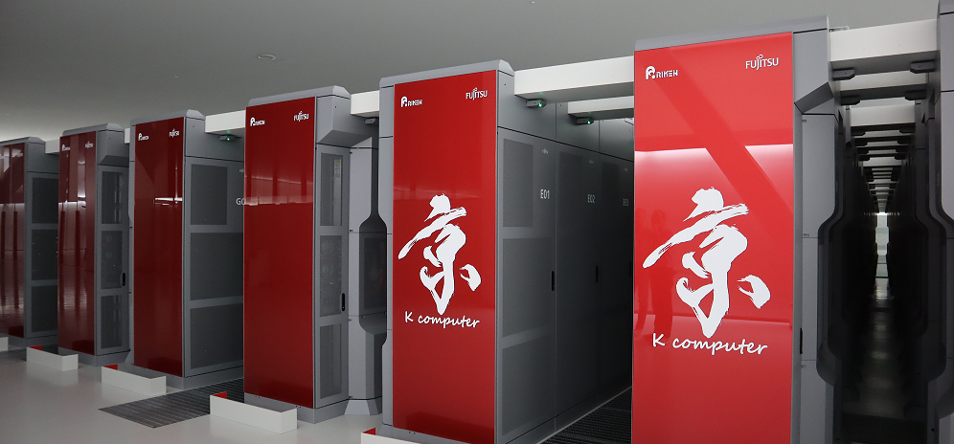
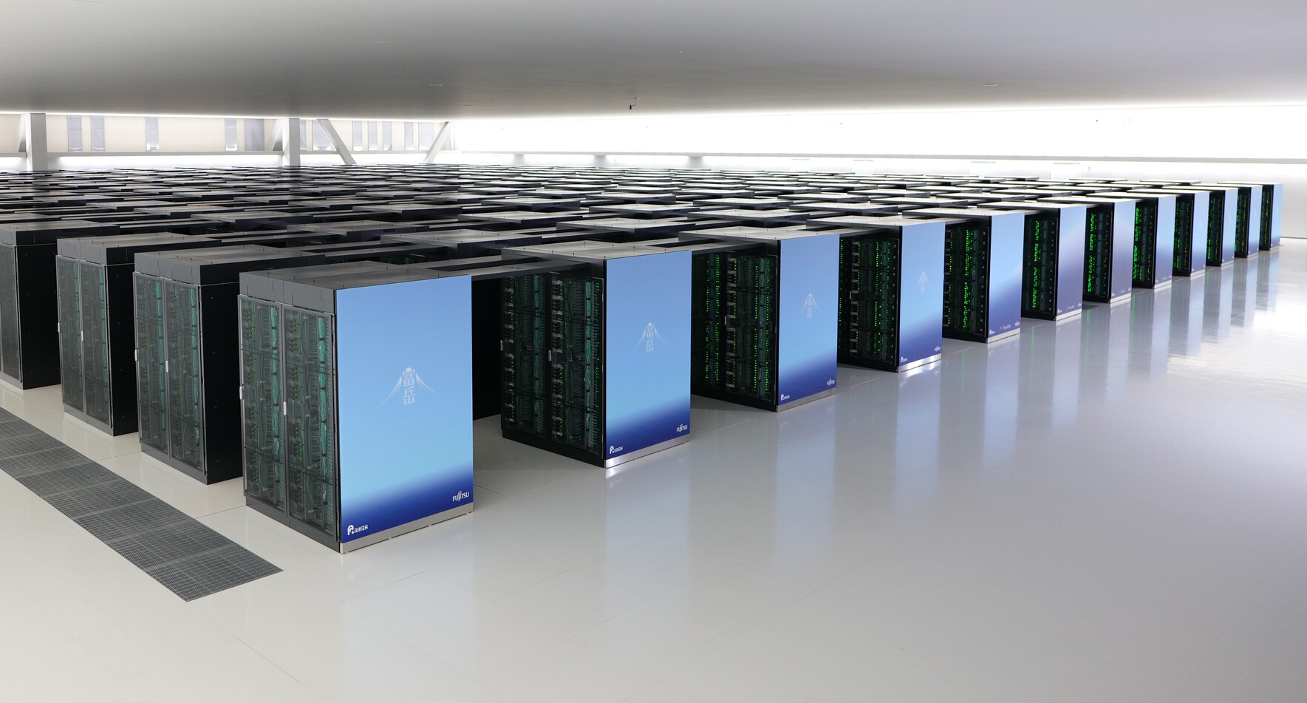
High Performance Computing Systems
Supercomputer Fugaku 富岳

Slide 3
Large data visualization on HPC

Slide 4
In-situ visualization

Slide 5
Parallel rendering
Order-independent technique for volume rendering

Slide 6
Data exploration for In-situ visualization
Multi-viewpoint omni-directional rendering

Slide 7
In-situ visualization on HPC environment
Blind exectuion

Slide 8
Smart in-situ visualization
Time to discover

Slide 9
In-situ timestep selection
Adaptive timestep selection for in-situ visualization

Slide 10


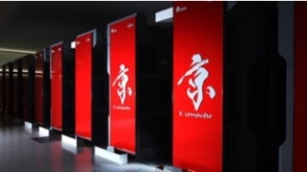

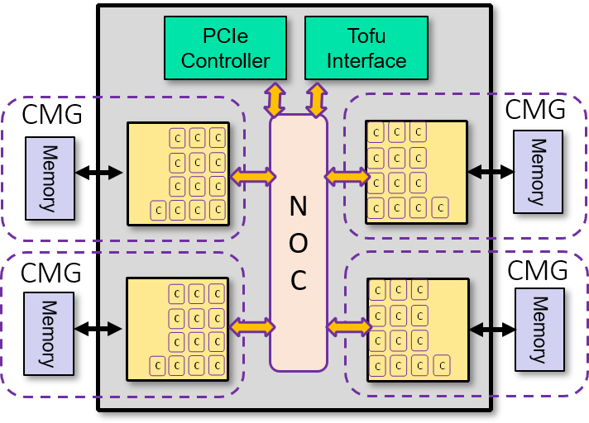


In-situ processing
Visualization and analysis become more challenging task for large-scale data generated from faster and powerful supercomputers.
RIKEN Center for Computational Science (R-CCS)
K computer was decommissioned after several years.
Fugaku system is underway
consist of more than 150,000 processing nodes
expected to deliver even larger volume of simulation results
K computer (SPARC)
OpenStack-based
Private Cloud
(x86/GPU)
Login Server
(x86)
In-situ
Local FS
Global FS
Fugaku Supercomputer
(ARM-based CPU)
In
Out
“Staging”
Post-hoc

Slide 11
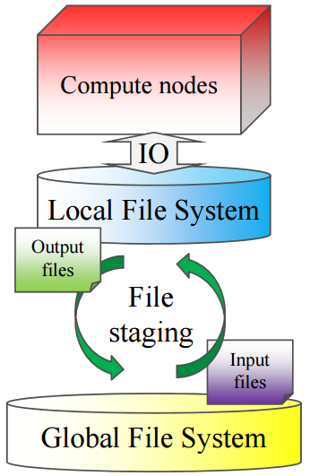
In-situ visualization
Pre-defined visualization parameters
File staging based in-situ processing
Large number of output images
Post-analysis with large image database
Difficult to find the important features related to the correct understanding of the underlying physical phenomena

Slide 12
Our approach
In-situ timestep selection
Based on the amount of change between the simulation timesteps
Helpful for the data I/O and visualization cost savings
Simulation
. . .
. . .
In-Situ Timestep Selection
Storage
Visualization

Slide 13
Proposed method
Adaptive timestep selection for in-situ visualization
Spatio-temporal variations between volumes
Adaptive timestep sampling
‥ ‥
V_{t-1}
V_{t}
‥ ‥
Variations
Not important
Important
Time
Not vis
Vis

Slide 14
Spatio-temporal variations
Time-varying simulations
0
1
t
Time
V₀
V₁
‥ ‥
V_{t}
‥ ‥
V_{t}^{m-1}
‥‥
V_{t}^{m}
V_{t}¹
V_{t}²
‥‥
V_{t}^{m+1}
V_{t} = {V_{t}¹,V_{t}², … , V_{t}^{m}, …, V_{t}^{M}}

Slide 15
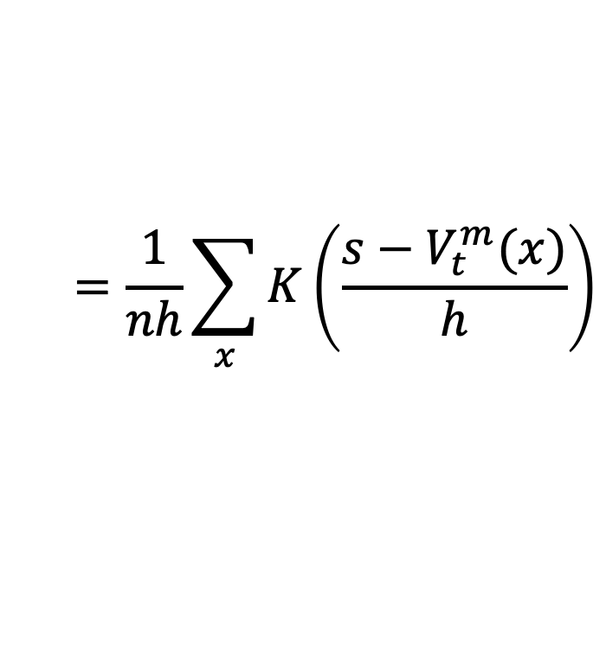
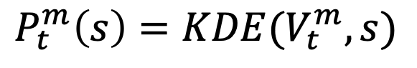
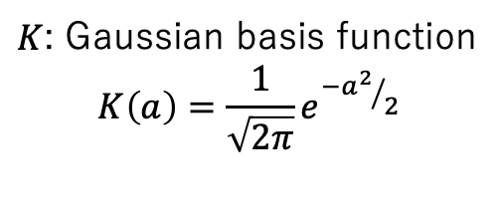
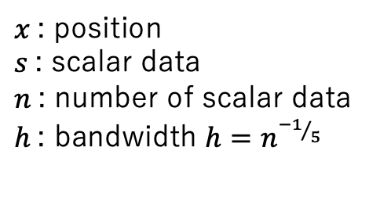
Spatio-temporal variations
Probability density function P of each subvolume
Kernel Density Estimation (KDE)
P
P_{t}^{m}
$$P_{t}^{m}\left(s\right)=KDE(V_{t}^{m},s)$$
$$=\frac{1}{nh}\sum_{x}{K\left(\frac{s−V_{t}^{m}(x)}{h}\right)}$$
‥‥
S
V_{t}^{m-1}
$x$: position
$s$: scalar data
$n$: number of scalar data
$h$: bandwidth $h=n^{{−1}/5}$
$K$: Gaussian basis function $$K\left(a\right)=\frac{1}{\sqrt{2π}}e^{{−a^{2}}/2}$$
‥‥
V_{t}^{m}
V_{t}¹
V_{t}²
‥‥
V_{t}^{m+1}

Slide 16
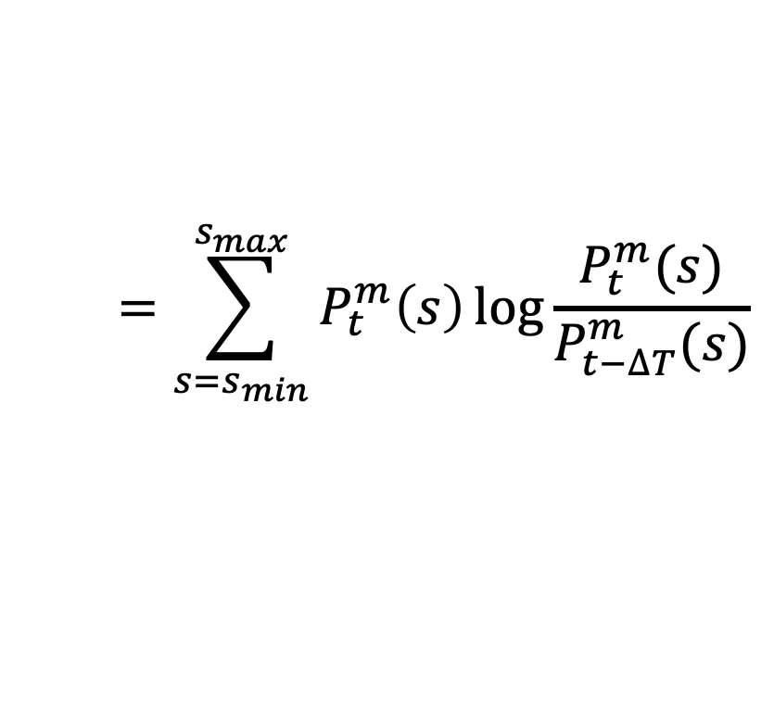
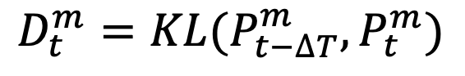
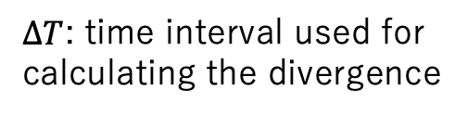
Spatio-temporal variations
Relative divergence D between PDFs
Kullback-Leibler (KL) divergence
t-ΔT
t
Time
$$D_{t}^{m}=KL(P_{t−∆T}^{m},P_{t}^{m})$$
V_{t-ΔT}
V_{t}
$$=\sum_{s=s_{min}}^{s_{max}}{P_{t}^{m}\left(s\right)\log{\frac{P_{t}^{m}(s)}{P_{t−∆T}^{m}(s)}}}$$
^{m}
P_{t-ΔT}
P_{t}^{m}
$∆T$: time interval used for calculating the divergence
‥‥
‥‥
D_{t}^{m}

Slide 17
Spatio-temporal variations
Relative divergence D between PDFs
Kullback-Leibler (KL) divergence
D_{t} = max(D_{t}¹, D_{t}², … , D_{t}^{m}, …, D_{t}^{M})
D
D_{t}^{m-1}
‥‥
D_{t}^{m}
D_{t}¹
D_{t}²
‥‥
Time
D_{t}^{m+1}
t - ΔT
t

Slide 18
Adaptive time sampling
Variation patterns
D
A
B
C
A
THR
T_{p-1}
T_{p}
T_{p+1}
Time
Δt
Δt’
ΔT
t₀
t₁
t₂
‥‥
‥‥
t’_{k-1}
t’_{k}
t’_{k+1}
‥‥

Slide 19
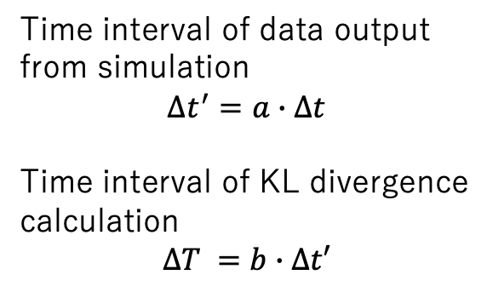
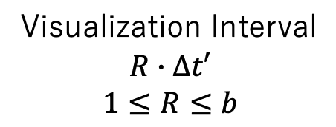
Visualization interval
Granularity R for low variation region
T_{p-1}
T_{p}
Time interval of data output
from simulation
$$∆t^{′}=a∙∆t$$
Time interval of KL divergence calculation
$$∆T =b∙∆t′$$
Time
Δt
Δt’
ΔT
Stacking
Fine
R = 1
Rendering
Visualization Interval
$$R∙∆t′$$
$$1≤R≤b$$
R = 2
Coarse
R = 4

Slide 20
Visualization interval
Granularity for each pattern
Pattern A
Coarse sampling
Using specified R
Pattern B
Fine sampling
Using R = 1
Pattern C
Combined sampling
Using R = 1 (fine) in the first half and specified R in the other half
A
B
C
Coarse
(Specified R)
Fine
(R = 1)
Fine
(R = 1)
Coarse
(Specified R)

Slide 21
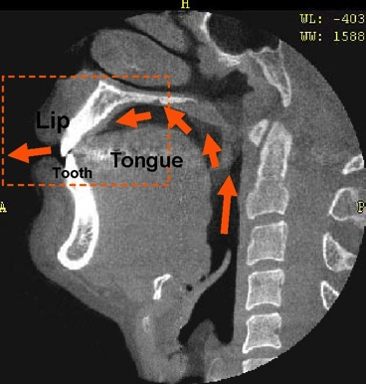
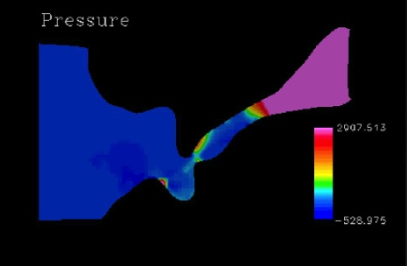
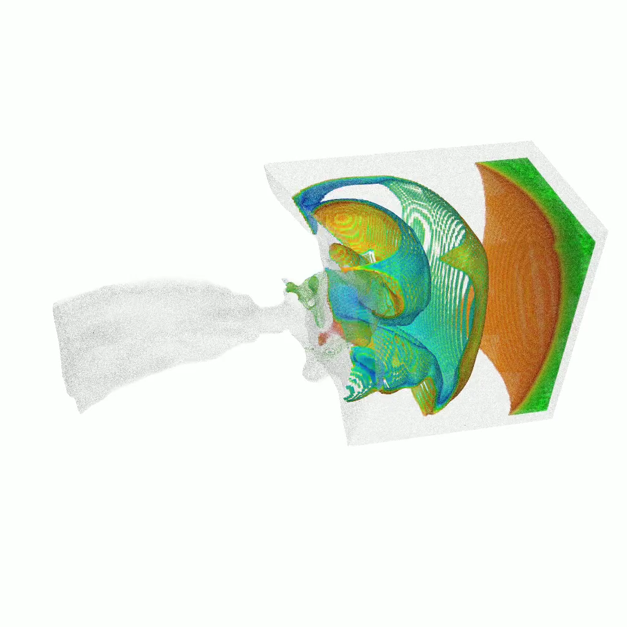
Experiment
Numerical simulation of sibilant fricatives
Implicit compressible flow solver based on OpenFOAM
Unstructured volumes
3,197,279 hexahedrons
48 subvolumes
20,000 timesteps

Slide 22
Experiment
Environment
K pre-post cloud system
X86 based on-premise could system
Dual Intel Xeon Platinum 8168 (Skylake) 24cores/2.7GHz
48 vCPUs on the VM for the evaluation
Software
Simulation: OpenFOAM
Visualization: KVS (original toolkit)
Parallel rendering: 234 image compositor

Slide 23
Result
Changes of KL divergence (D)
Simulation timesteps: 20,000
KL divergence calculation interval (ΔT): 100
Number of simulations (a): 5
Number of stacking data (b): 20
KL divergence
Time step

Slide 24
Result
Number of vis. images and reduction ratio
Total number of stacked data: 4,000
THR | R=5 | R=10
0 | 4,000 (0%) | 4,000 (0%)
0.01 | 3,452 (13.7%) | 3,384 (15.4%)
0.02 | 3,100 (22.5%) | 2,896 (21.6%)
0.03 | 2,856 (28.6%) | 2,616 (34.6%)
0.04 | 2,496 (37.6%) | 2,288 (42.8%)
0.05 | 2,064 (48.4%) | 1,892 (52.7%)
THR: Threshold for the KL divergence (D)
R: Granularity for the time sampling for A and C interval patterns

Slide 25
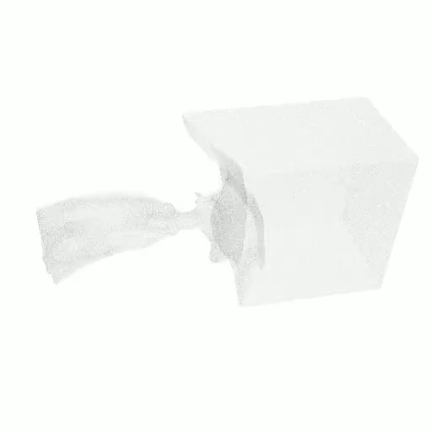
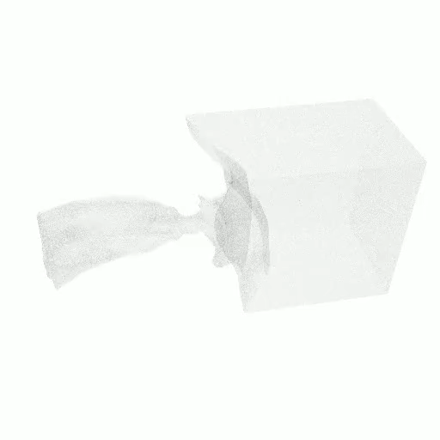
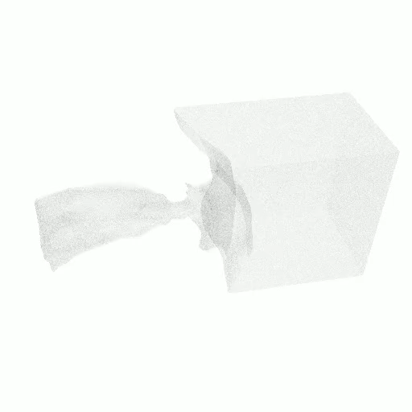
Result
In-situ visualization results with and without our method
THR = 0.005
Original
(4,000 images)
Our method with R=5
(2,064 images)
Our method with R=10
(1,892 images)

Slide 26
Conclusion
Adaptive timestep control for in-situ visualization
Spatio-temporal variations between the simulation results based on the Kullback-Leibler divergence
Adaptive timestep control in consideration of the variation changing patterns
Utilizing adaptive timestep sampling mechanism for reducing the amount of data for the subsequent processing (e.g. data storing for the post-hoc visualization and analytics, in-situ/in-transit visualization)
Future works
Optimal parameter selection for the input time intervals
Viewpoint selection without missing significant physical phenomenon

Slide 27
Acknowledgements
This work was partially supported by
Grant-in-Aid for Scientific Research (JSPS KAKENHI)
20H04194
19H03976
Collaborative Research Program of Education Center on Computational Science and Engineering, Kobe University

